Slide 1

QUADRATIC EQUATIONS
3ST OCTOBER 2026

Slide 2
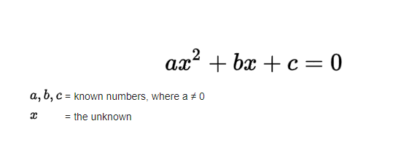
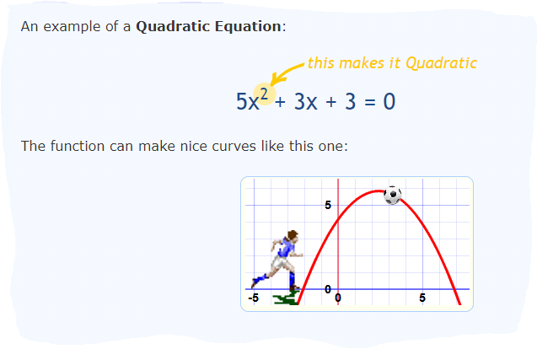

Slide 3
Introduction
A quadratic equation is an equation that has a second degree polynomial ie the equation that has two (2) as the highest power of its variable(s).
A polynomial can be easily defined as a mathematical expression (consisting of variables, constants, and exponents combined by mathematical operations).
A quadratic equation takes the form;
aX² +bX + c = 0;
Where a, and b are coefficients and c is a constant. To be more specific, a is called a leading coefficient.
In a quadratic equation; b and c can be zero (0) but not a (a≠0).

Slide 4
Examples of quadratic equations
They include;
5X²+11X-35=0
2X²=3X-17
6X²=8
The above examples can be re-written into the form; aX² +bX + c = 0 for easy solving. There are different methods of solving quadratic equations, such as; graphical, factorization, and quadratic formula methods.
NOTE: A quadratic equation can have; two real solutions, one real solution or no real solution as explained in sections below.

Slide 5
Graphical solution
To plot a quadratic function, say Y= aX² +bX + c; you compute values of Y for different assumed values of X to come up with coordinates (X_{i}Y_{j}) which can be plotted on a graph.
The graph of a quadratic equation is a PARABOLA (U-shaped curve) and it’s symmetric.
The solutions of aX² +bX + c = 0 are the values of X where the parabola touches the X-axis.
It is important to note that the parabola can touch the X -axis twice, once or not at all as illustrated in the following figures (though not conclusive).

Slide 6
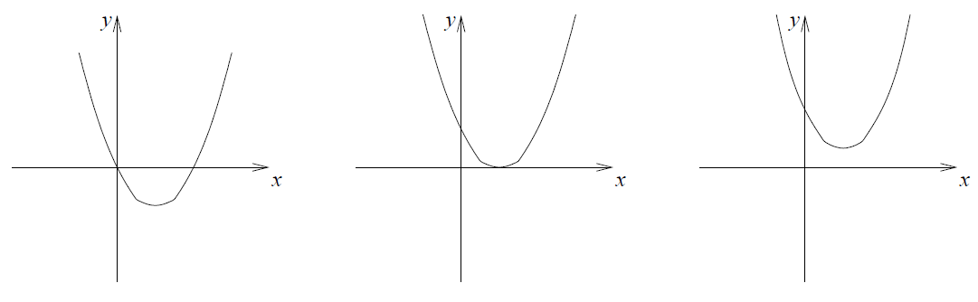
Graphical solution (Illustrations for a Parabola)

Slide 7
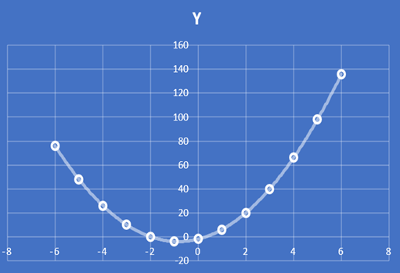
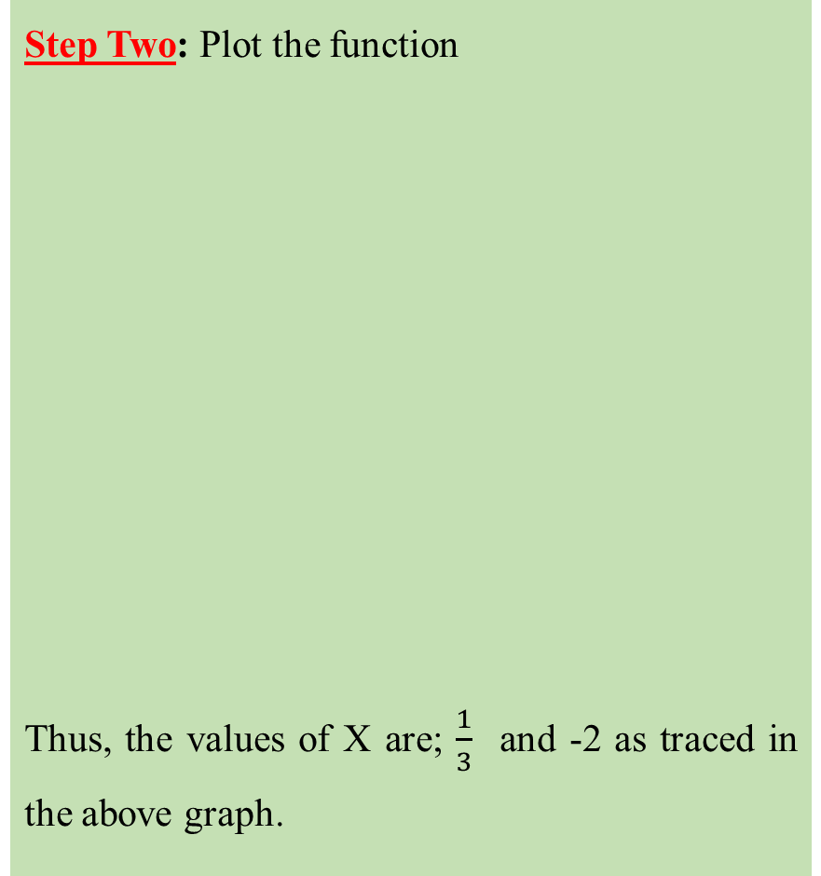
Example: Plot the equation 3X² +5X-2=0 on a graph
Step One: Compute the different coordinates (X_{i}Y_{j}) of the function 3X² +5X-2=0 to plot the graph
Step Two: Plot the function
Thus, the values of X are; $\frac{1}{3}$ and -2 as traced in the above graph.
X | Y
0 | -2
1 | 6
2 | 20
3 | 40
4 | 66
5 | 98
6 | 136
-1 | -4
-2 | 0
-3 | 10
-4 | 26
-5 | 48
-6 | 76

Slide 8
Exercise
Plot the quadratic functions below on a graph.
Y= X²+2x+5
5X²+11X-35=0
Y= 4X- 3X²

Slide 9
FACTORIZATION
Factorization is the process of finding expressions that can be multiplied to get the expression on one side of the equation.
Factoring operates on the zero-product property that states; If A* B= 0 then, either A= 0 or B= 0; where A and B are real numbers or expressions. This is because any number multiplied by a zero, the product is zero.
NOTE:
This method is only used when the quadratic equation can be factorized otherwise not. In cases where it can’t be factorized, it is advisable to use the quadratic formula.
To solve a quadratic equation, it is IMPORTANT to first note whether the leading coefficient is equal to one (a=1) or if it’s greater or equal two (a ≥2). These two scenarios call for different approaches as explained in the examples below.

Slide 10
Examples (Solve the quadratic equations in the table below using the factorization method)
When the leading coefficient is one (a=1)
Solve X²+X-6=0 Step 1: Find two numbers whose product equals c (-6) and whose sum equals b (1). a=1, b=1, c= -6 Factors of -6: 1*-6= -6 2*-3 = -6 -2*3= -6 We choose numbers -2 and 3; since -2*3= -6 and -2+3= 1 Step 2: Then use those numbers to write two factors of the form (x+k) or (x-k), where k is one of the numbers found in step 1 above. Use the numbers exactly as they are. The two factors are: (x+3) and (X-2) | Step 3: Solve by using the zero-product rule and by equating each factor to zero. Zero product rule: A*B=0; where either A=0 or B=0 Thus; (x+3) (X-2) = 0 So either (X-2) = 0 or (x+3) =0 X-2= 0 and x+3 =0 X=2 and x= -3

Slide 11
Examples (Solve the quadratic equations in the table below using the factorization method)
When the leading coefficient is greater or equal to two (a ≥2)
Solve 2X²+9X+4=0 Step 1: Find two numbers whose product equals ac(2*4) and whose sum equals b (9). a=2, b=9, c=4; thus ac=8 Factors of 8: 1*8= 8 2*4 = 8 We choose numbers 1 and 8; since 1*8= 8 and 1+8= 9 Step 2: Re-write the equation replacing bX term with the two terms using the numbers found in step 1 above as coefficients of X. 2X²+1X +8X+4=0 | Step 3: Factor the first two terms and then factor the last two terms. Note that the expressions in the parentheses (brackets) must exactly be the same to use GROUPING. (2X²+1X) +(8X+4) =0 X(2X+1) +4(2X+1) =0 Step 4: Factor out the expression in parentheses (2X+1) (X+4) =0 Step 5: Set the expressions equal to zero and solve for the variable (using the zero-product rule). Thus; (2X+1) = 0 and (X+4) =0 So 2X+1 = 0 and X+4 =0 X= -0.5 and x=-4

Slide 12
Exercise
Solve the quadratic functions below by factorization.
NOTE: For more examples on factorization, follow the link below:
https://math.libretexts.org/Bookshelves/Algebra/Algebra_and_Trigonometry_1e_(OpenStax)/02%3A_Equations_and_Inequalities/06%3A_Quadratic_Equations
2X²+10X+12=0 4X²-25=0 X²+4X=0 | X²-9=0 Y²+6Y+9=10

Slide 13
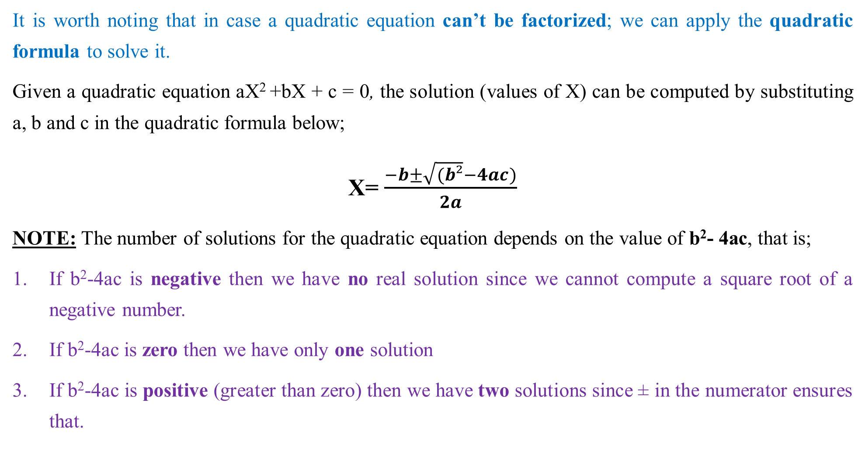
THE QUADRATIC FORMULA
It is worth noting that in case a quadratic equation can’t be factorized; we can apply the quadratic formula to solve it.
Given a quadratic equation aX² +bX + c = 0, the solution (values of X) can be computed by substituting a, b and c in the quadratic formula below;
X=$\frac{−b±\sqrt{(b²}−4ac)}{2a}$
NOTE: The number of solutions for the quadratic equation depends on the value of b²- 4ac, that is;
If b²-4ac is negative then we have no real solution since we cannot compute a square root of a negative number.
If b²-4ac is zero then we have only one solution
If b²-4ac is positive (greater than zero) then we have two solutions since ± in the numerator ensures that.

Slide 14
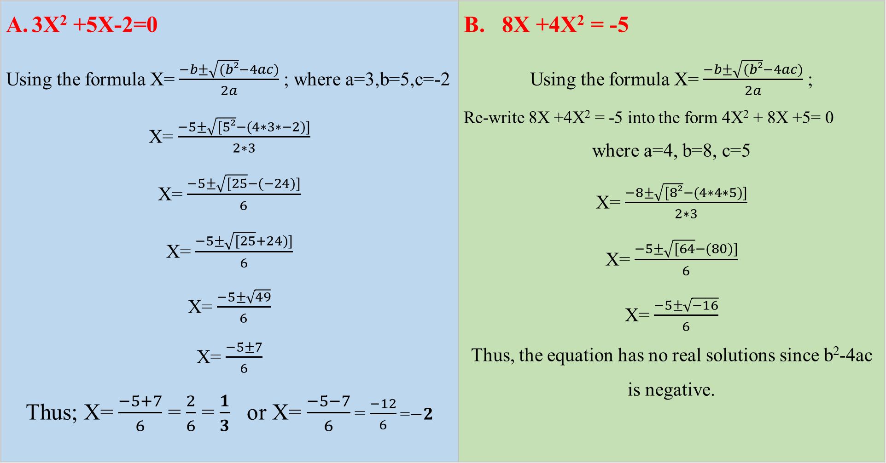
Examples (Solve the following equations using the quadratic formula)
3X² +5X-2=0 Using the formula X=$\frac{−b±\sqrt{(b²}−4ac)}{2a}$ ; where a=3,b=5,c=-2 X=$\frac{−5±\sqrt{[5²}−(4∗3∗−2)]}{2∗3}$ X=$\frac{−5±\sqrt{[25}−(−24)]}{6}$ X=$\frac{−5±\sqrt{[25}+24)]}{6}$ X=$\frac{−5±\sqrt{49}}{6}$ X=$\frac{−5±7}{6}$ Thus; X=$\frac{−5+7}{6}$ =$\frac{2}{6}$ =$\frac{1}{3}$ or X=$\frac{−5−7}{6}$ =$\frac{−12}{6}$ =$−2$ | B. 8X +4X² = -5 Using the formula X=$\frac{−b±\sqrt{(b²}−4ac)}{2a}$ ; Re-write 8X +4X² = -5 into the form 4X² + 8X +5= 0 where a=4, b=8, c=5 X=$\frac{−8±\sqrt{[8²}−(4∗4∗5)]}{2∗3}$ X=$\frac{−5±\sqrt{[64}−(80)]}{6}$ X=$\frac{−5±\sqrt{−16}}{6}$ Thus, the equation has no real solutions since b²-4ac is negative.

Slide 15
Exercise
Solve the following using the quadratic formula;
X²+6X+9=0
7M²+6M=-1
2X²+4X+2=0

Slide 16
Quadratic simultaneous equations
Quadratic simultaneous equations refer to a set of two or more equations that share variables raised to the power of TWO (2) utmost. Examples of such equations;
A. Y= X+2 Y=X²+5x-7 | B. Y²=29-X² Y=X+5
C. X²+6X+9=Y 7X²+6X+1=Y 2X²+4X+2=Y | D. Y=2X2+10X+12 Y²=4X²-25 Y=X²+4X

Slide 17
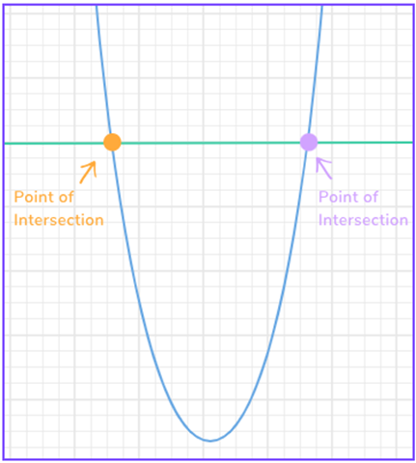
Quadratic simultaneous equations (Ct’d)
It is important to note that under Quadratic simultaneous equations, one can get multiple solutions since the graphs can intersect on a number of points.
Take a look at the diagram (plot of a linear equation and a quadratic equation) on the side; we have two right answers since we have two points of intersection.
NOTE: To solve Quadratic simultaneous equations we borrow the same methods that we used in solving systems of linear simultaneous equations (ie graphical, elimination and substitution methods) in CHAPTER 5.

Slide 18
Polynomials
A polynomial can be defined as a mathematical expression that consists of variable(s), constant(s), exponent(s) combined by one or more mathematical operations.
It can also be defined as a mathematical term or a combination of two or more terms by mathematical operations (a TERM is a constant or product of a constant and one or more variables).
A polynomial can be either a monomial or binomial or trinomial.
Note that there is are no special names for polynomials with more than three terms; they are just broadly categorized as polynomials.

Slide 19
Polynomials (Ct’d)
Note that there is are no special names for polynomials with more than three terms; they are just broadly categorized as polynomials.
Monomial- A polynomial with exactly one term eg 4; 4X; 2X²
Binomial- A polynomial with exactly two terms eg 2+ 4X; 2X² +X
Trinomial- A polynomial with exactly three terms eg 3X²+3+ 4X; 2X² +X+4X⁴
Polynomial- a combination of either one or two or all of the above plus as many other terms as possible. For example;
X+1 4M²-5M+2 X⁴+X³+4X²-3X+2 | 2X³+9XY 6M⁴-M³+9M²+7MX²+ MX+1

Slide 20
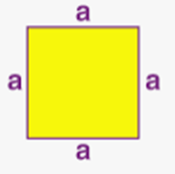
  Agricultural Application and solving related problems
Quadratic equations are used in day-to-day life in the following circumstances;
Computing the area of a square; Area = a* a = a^2
Profit determination (from either one or more products)
Generally, Profit= Revenue- Cost; But in cases where the profit per product (say X) is known for quantity q sold;
Profit (q) = Xq
In scenarios where you have many products sold
Revenue (qj) = Xiqj = X1q1 + X2q2 + X3q3 + ……………………. + Xnqn
NOTE: The profit function can be linear or nonlinear (because profit does not scale linearly for all quantities).
For more applications of quadratic equations, follow the link below; https://www.byjusfutureschool.com/blog/what-practical-applications-do-quadratic-equations-have-in-real-life/

Slide 21

Thank you
@ASK

